Slide 1
Green University of Bangladesh
Computer science and engineering
Name :Jakirul Islam
ID : 193002101
Topic : Matrix

Slide 2
Learning objectives :
What is matrix
Dimensions of a matrix
Transpose matrix
Why do we use matrix

Slide 3
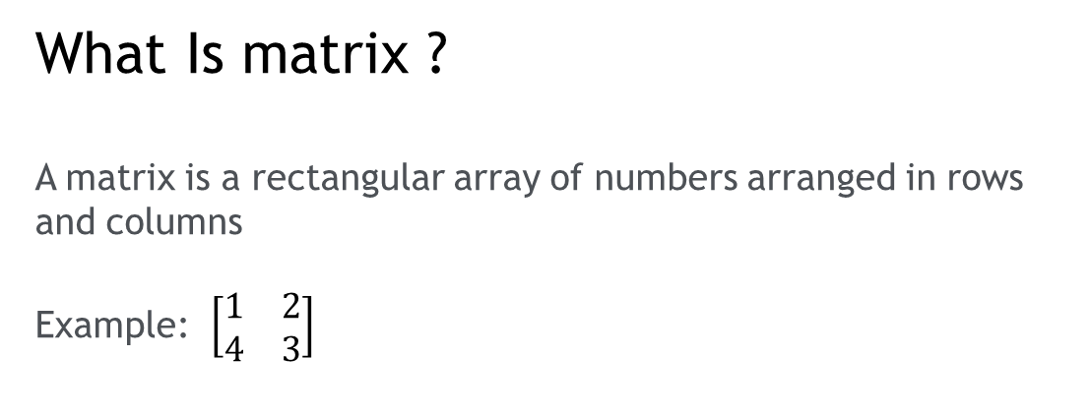
What Is matrix ?
A matrix is a rectangular array of numbers arranged in rows and columns
Example: $\left[\begin{matrix}1 & 2 \\ 4 & 3\end{matrix}\right]$

Slide 4
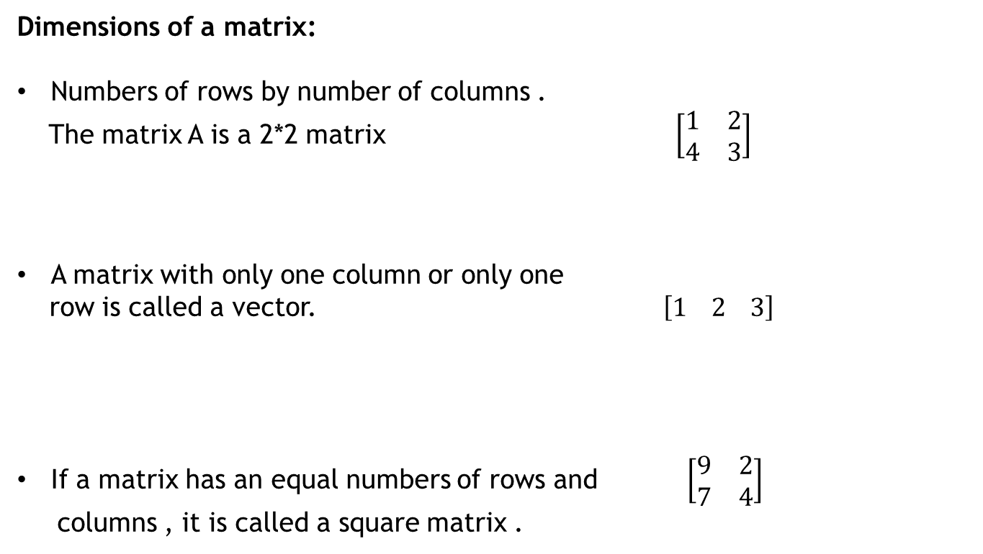
Dimensions of a matrix:
Numbers of rows by number of columns .
The matrix A is a 2*2 matrix $\left[\begin{matrix}1 & 2 \\ 4 & 3\end{matrix}\right]$
A matrix with only one column or only one
row is called a vector. $\left[1 2 3\right]$
If a matrix has an equal numbers of rows and $\left[\begin{matrix}9 & 2 \\ 7 & 4\end{matrix}\right]$
columns , it is called a square matrix .

Slide 5
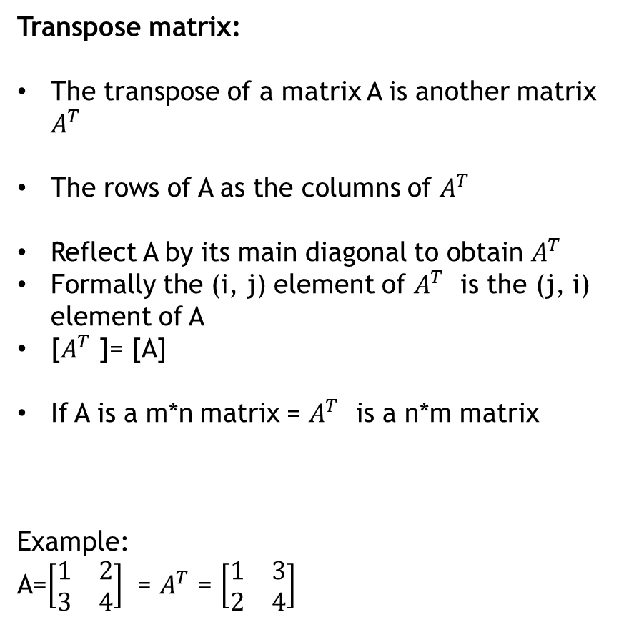
Transpose matrix:
The transpose of a matrix A is another matrix $A^{T}$
The rows of A as the columns of $A^{T}$
Reflect A by its main diagonal to obtain $A^{T}$
Formally the (i, j) element of $A^{T}$ is the (j, i) element of A
[$A^{T}$ ]= [A]
If A is a m*n matrix = $A^{T}$ is a n*m matrix
Example:
A=$\left[\begin{matrix}1 & 2 \\ 3 & 4\end{matrix}\right]$ = $A^{T}$ = $\left[\begin{matrix}1 & 3 \\ 2 & 4\end{matrix}\right]$

Slide 6
Why do we use matrix :
A matrix multiplication diagram. Among the most common tools in electrical engineering and computer science are rectangular grids of numbers known as matrices.
The numbers in a matrix can represent data, and they can also represent mathematical equations

Slide 7


